Slide 1
AUTO INSURANCE FRAUD CLAIMS DETECTION
By P.N.S.S.CHAKRAVARTHI
From batch121
EMPID:5129

Slide 2

Problem Statement
The data that I have is from Automobile Insurance. I will be creating a predictive model that predicts if an insurance claim is fraudulent or not.
The major general insurance company is facing a problem of significant fraudulent claims being reported, leading to leakages. The company wants to predict fraudulent claims before processing them to allocate costs appropriately and design a proper action plan.
Motor and health insurance segments have seen a spurt in fraud, and frauds can be classified from source and nature points of view. The prediction framework will be useful for insurance companies, regulatory bodies, and law enforcement agencies to reduce costs, minimize losses, and prevent frauds. The company wants to understand the hidden patterns in data to construct an investigation process and claim settlement decision.

Slide 3


Business Case
Claim related fraud is a huge problem in the insurance industry. It is quite complex and difficult to identify those unwanted claims.
I am trying to troubleshoot and help the Insurance industry with this problem.
If insurance frauds are classified into two types:
Source type frauds
Policyholder
intermediary and/or internal nature
Nature type
Application
Inflation
Identity
Fabrication
Staged/contrived/induced accidents

Slide 4

ROI
A framework which will determine whether a customer claim is fraud or genuine from the given details.
By this a possible detection of fraudulent ones before even processing the claims can be done to allocate costs appropriately.
By accurately predicting which claims are likely to result in vehicle repairs rather than total losses, we can more effectively manage our vehicle repair supply chain and reduce overall repair costs.
Our machine learning model can help us identify claims that are likely to result in liability disputes, allowing us to allocate resources more effectively and potentially reducing legal expenses for the company.
By accurately predicting which auto insurance claims are fraudulent, we can reduce the number of fraudulent claims that are paid out, resulting in a significant cost savings for the company.

Slide 5
Machine Learning Problem
This business case comes under classification problem in Supervised Learning method.
The features for the machine learning model include a variety of information related to the Demographic, Policy, Claim, Vehicle, Fraud information. The target variable for the machine learning model would be a binary variable indicating whether or not the claim is fraudulent.
Once we have identified the features and the target variable, we can start exploring and cleaning the data, engineering new features.
Selecting an appropriate machine learning algorithm to train and test the model.
Evaluating the Model.

Slide 6
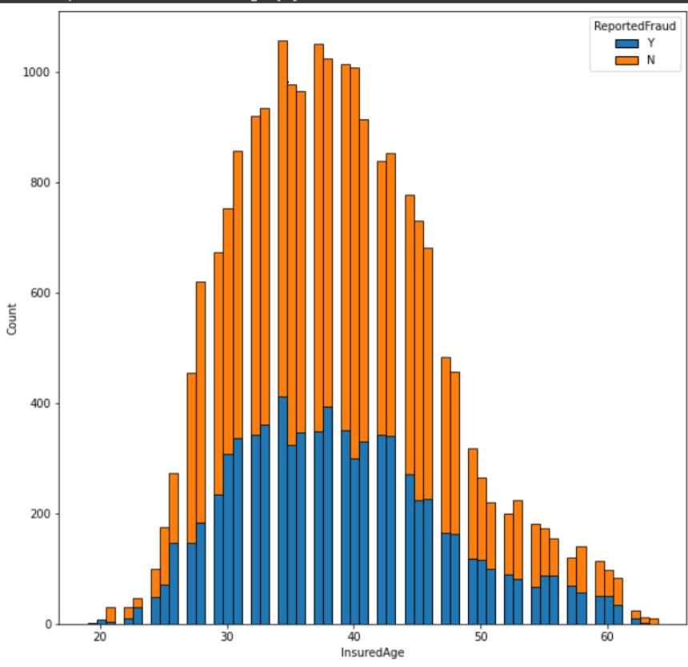
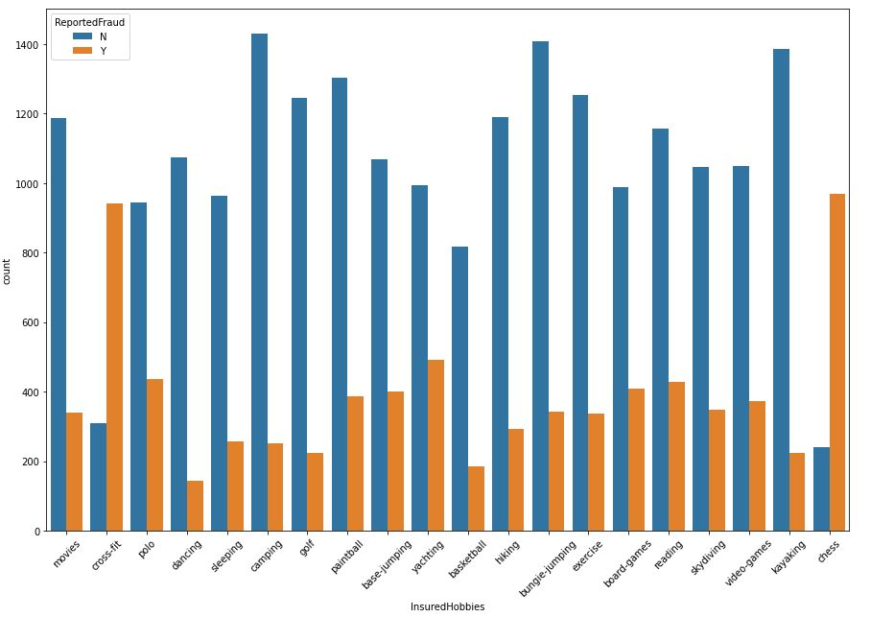
ABOUT DATA
Demographics Data
Policy Information
Claim Information
Data of Vehicle
Details of Insured person
CustomerID
InsuredAge
InsuredZipCode
InsuredGender
InsuredEducationLevel
InsuredOccupation
InsuredHobbies
CapitalGains
CapitalLoss
Country
One thing which is striking in this graph is that people with chess and cross-fit as hobby have extremely high number of fraudulent claims.
People in the age group between 30-45 have more number of frauds
28836 X 10

Slide 7
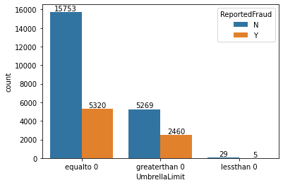
ABOUT DATA
Demographics Data
Policy Information
Claim Information
Data of Vehicle
Details of Policy
CustomerID
CustomerLoyaltyPeriod
InsurancePolicyNumber
DateOfPolicyCoverage
InsurancePolicyState
Policy_CombinedSingleLimit
Policy_Deductible
PolicyAnnualPremium
UmbrellaLimit
InsuredRelationship
The ratio of ReportedFraud in UmberillaLimit greaterthan 0 is more.
28836 X 9

Slide 8
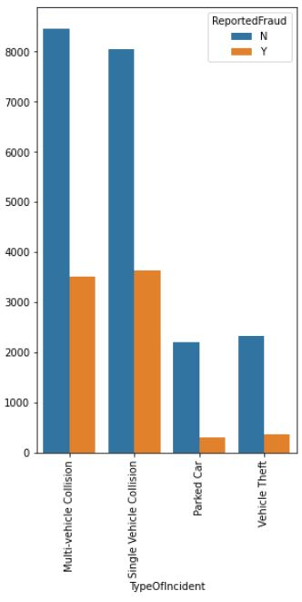
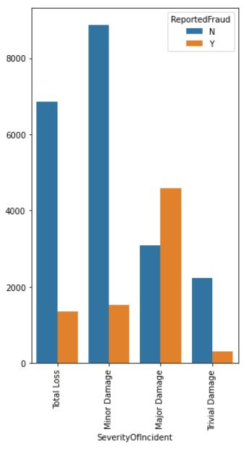
ABOUT DATA
Demographics Data
Policy Information
Claim Information
Data of Vehicle
Multi-vehicle and single vehicle collisions have more number of frauds compared to parked and vehicle theft. One of the reasons could be that in a collision, there is high possibility of more damage to car, as well as the passengers and hence the need to file false insurance claims.
Claim related details
CustomerID
DateOfIncident
TypeOfIncident
TypeOfCollission
AuthoritiesContacted
IncidentCity
IncidentTime
NumberOfVehicles
Claim related details
PropertyDamage
BodilyInjuries
Witnesses
PoliceReport
AmountOfTotalClaim
AmountOfInjuryClaim
AmountOfPropertyClaim
AmountOfVehicleDamage
28836 X 19
Here, compared to minor damage, total loss and trivial damage, fraudulent claims are highest in major damage. One of the reason could be that the high amount of repair cost which will be incurred by the insurer due to major damage.

Slide 9
ABOUT DATA
Demographics Data
Policy Information
Claim Information
Data of Vehicle
Vehicle related Data
CustomerID
VehicleID
VehicleMake
VehicleModel
VehicleYOM
28836 X 5
Target Fraud
Frud Data
CustomerID
ReportedFraud

Slide 10
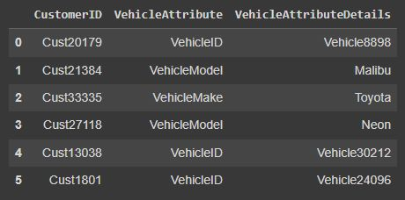
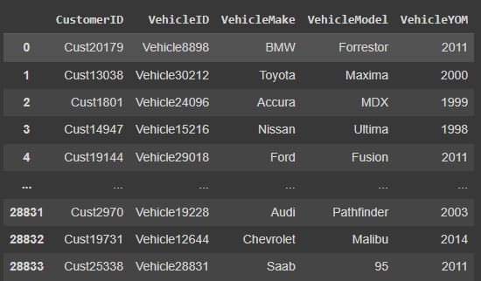
DEALING DATA
Grouped the vehicle data through recursive grouping
Merged given Data on CustomerId
Did summary statistics
Dropped unnecessary columns such are Ids ,country.
As the whole data was recorded in 2015 at india only
Country, year from IncidentDate were dropped
CustomerID, PolicyNumber, IncidentAddress were dropped due to high cardinality and no effect on target.
Converted columns into relevant datatypes

Slide 11

Feature Engineering
Splitted DateofIncident,DateofPolicyCoverage columns into year, month, day columns
Splitted policy_CombinedSingleLimit column to Singlelimit and combinedlimit through split(‘/’) string method
A Combined Single Limit (CSL) is a type of liability insurance policy that provides a single limit of coverage for both bodily injury and property damage claims. This means that the policy has a total dollar limit that applies to all covered claims, regardless of whether they are related to bodily injury or property damage
.For example, let's say that you have a CSL insurance policy with a limit of $1 million. If you get into an accident and cause $800,000 in bodily injury damages and $400,000 in property damage, the CSL policy would cover both types of damages up to the $1 million limit
Created a vehicle_lifetime feature through (incident_Year – VehicleYOM)
Created state_city feature using string concatenation of IncidentState, IncidentCity
Created netamount feature through (Capital_Gain + Capital_Loss)

Slide 12
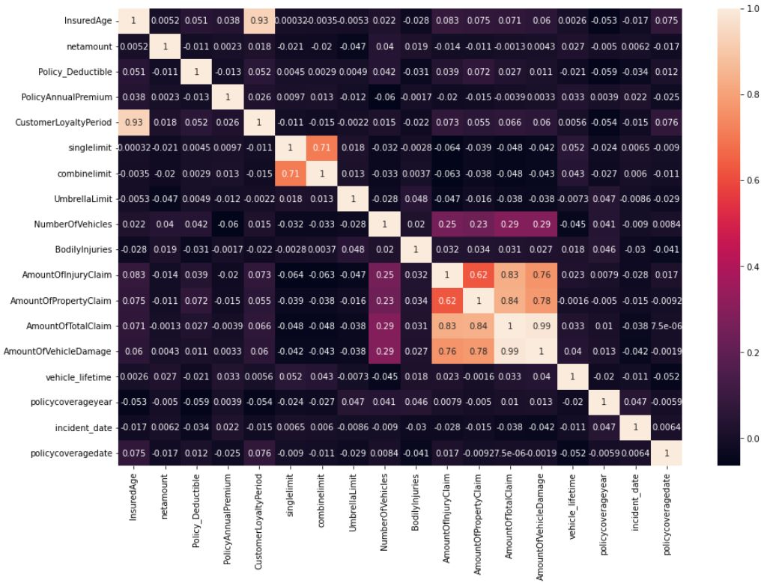
From the Correlation plot:
AmountOfTotalClaim, AmountOfInjuryClaim, AmountOfPropertyClaim
AmountOfVehicleDamage
Have high correlation among other attributes
Here Multi-collinearity exists hence AmountOfTotalClaim has been removed

Slide 13
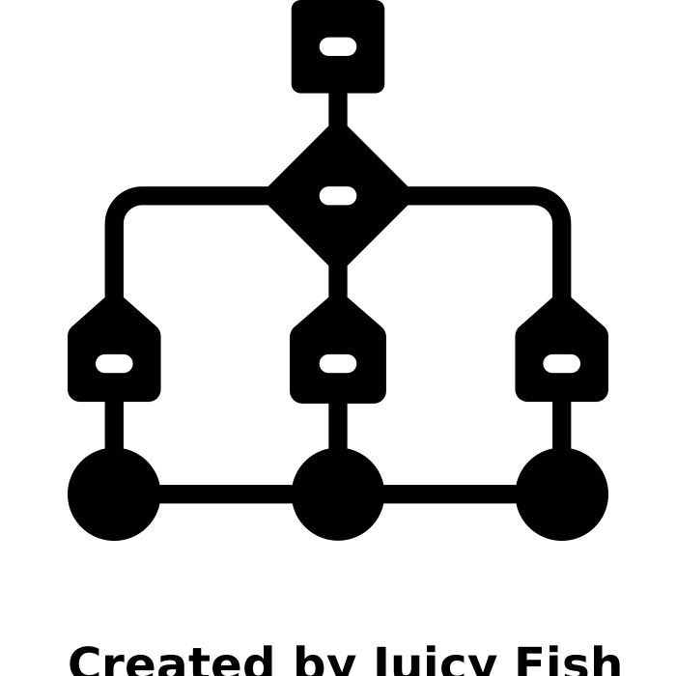
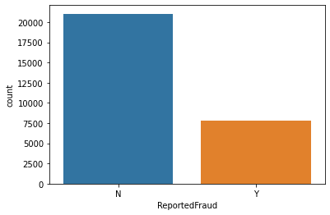
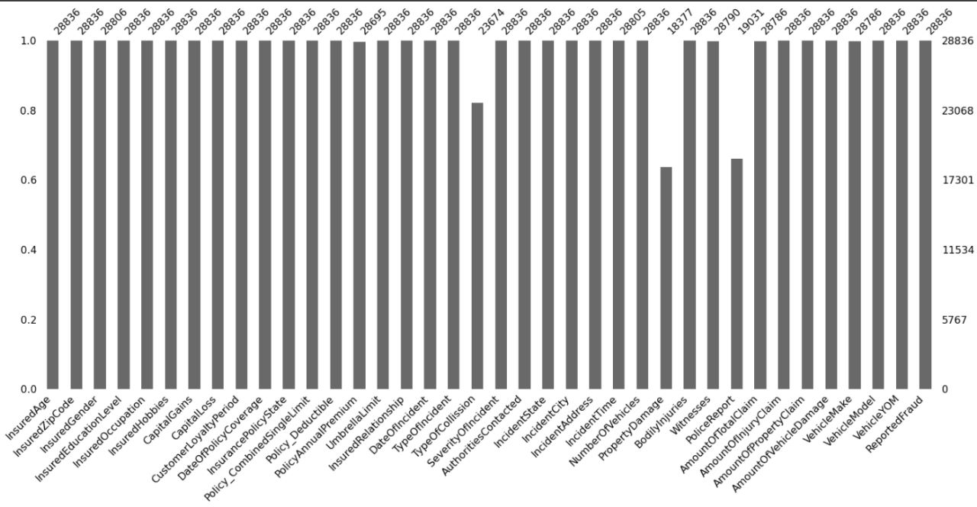
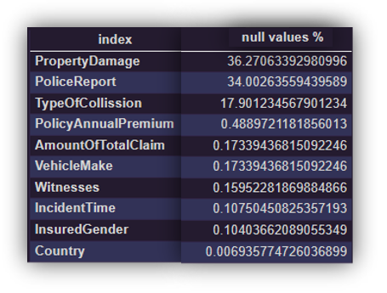
CHALLENGES
Imbalenced Data
Missing Data
On recorded observation there are more number of Nonfraudulent insured persons than fraudulent insured persons and the ratio is
N : 73.0
Y : 26.9
There are lot of missing values in the given data
The percentages of missing values in the data are as:

Slide 14
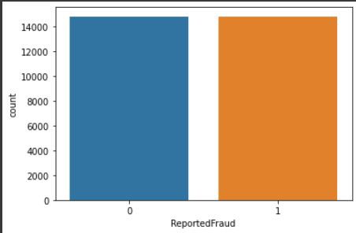
Used SMOTE
Used KNN IMPUTER
Oversampling involves creating synthetic examples of the minority class to increase its representation in the dataset. This can be done by either replicating existing examples or generating new ones using techniques such as SMOTE (Synthetic Minority Over-sampling Technique).
KNN imputation is a technique used to impute missing values in a dataset. The basic idea behind KNN imputation is to find the K nearest neighbors of each observation with missing values, based on a similarity metric such as Euclidean distance, and then use the average or weighted average of the non-missing values of those neighbors to impute the missing value.
Used fillna() method for columns containing less percentage of null values

Slide 15
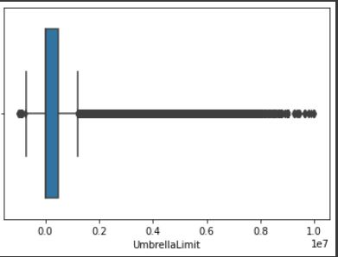
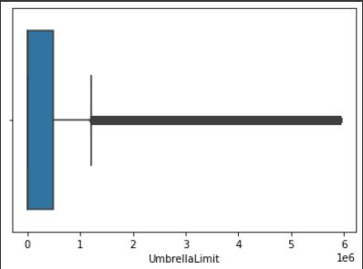
Techniques Used
Handling Outliers
Winsorization is a technique used in statistics to limit the effect of outliers by capping the extreme values in a dataset. The technique involves setting the extreme values of a UmberellaLimit to a specified percentile of the data.
The most common form of winsorization is to set the extreme values to the 1st and 99th percentiles of the data, which effectively caps the data at 1% and 99% of the range of the data.
Winsorization can be useful when dealing with datasets that have extreme values, which can skew the distribution and affect statistical analysis. By capping the extreme values, the distribution of the data can be made more normal, and the results of statistical analysis can be more reliable.

Slide 16
Techniques Used
OrdinalEncoding
Ordinal encoding is a technique used to encode categorical variables with ordered values. It assigns a unique numerical value to each category, based on their order or rank. When applying ordinal encoding to the "education" column, you would first need to define the order of the categories. For example, you might consider the following order, from lowest to highest:
InsuredEducationLevel-->'High School’:0 ,'Associate’:1, 'College’:2 ,'Masters’:3 ,'JD’:4 ,'MD’:5 ,'PhD’:6
SeverityOfIncident --> 'Trivial Damage’:0 ,'Minor Damage’: 1,'Major Damage’: 2,'Total Loss’: 3
OneHotEncoding
In one hot encoding, each unique category in a categorical variable is transformed into a binary vector with a length equal to the number of categories. The vector contains 1 in the position corresponding to the category and 0 in all other positions.
train_test_split
test_size=0.3
train_size=0.7
Splitting the dataset into train and test sets. Train set is for model Building. Test set is for model evaluation
Standradization
Standardization is a scaling method where the values are centered around the mean with a unit standard deviation. This means that the mean of the attribute becomes zero, and the resultant distribution has a unit standard deviation.

Slide 17
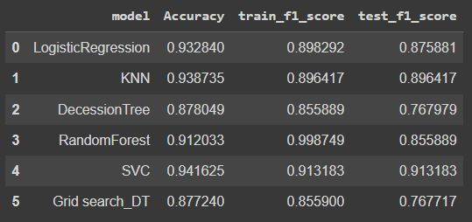
MODEL BUILDING
Algorithms Built
Among the following models SVM model works better for this data
SVM
Decision Tree
Logistic Regression
KNN
Random Forest
Hyperparameter Tuning using GridSearch_CV
Best Model:
SVM Classifier
Support Vector Machine (SVM) is a supervised learning algorithm used for classification, regression. It works by finding the optimal boundary that separates the different classes in the data. In SVM, a hyperplane is used to separate the classes. The goal is to find the hyperplane that maximizes the margin between the closest points of the different classes. These closest points are called support vectors.The SVM algorithm can handle linear and non-linear data by using different types of kernels. A kernel is a function that maps the data to a higher-dimensional space where it becomes linearly separable. The most commonly used kernels are linear, polynomial, and radial basis function (RBF).

Slide 18
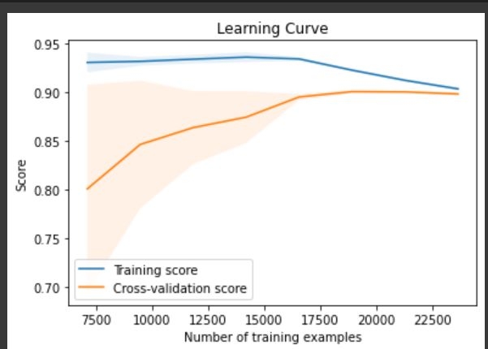
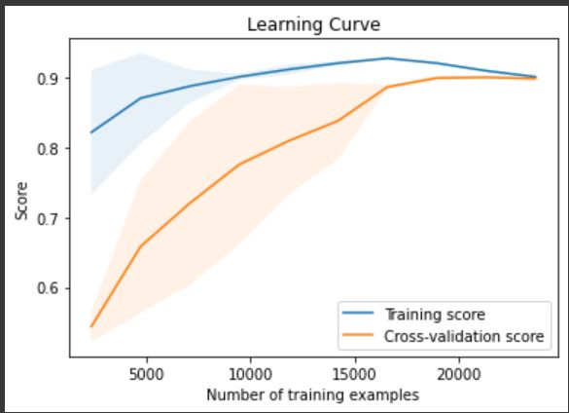
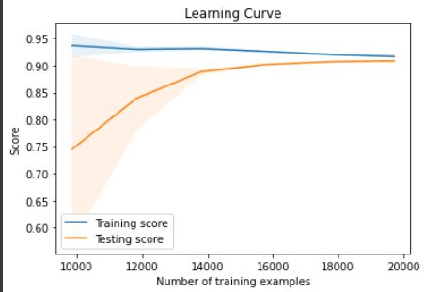
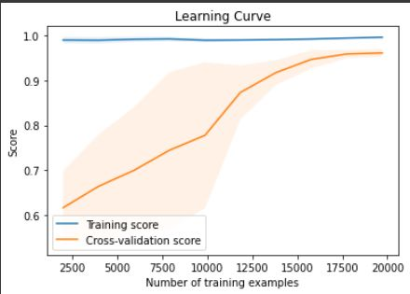
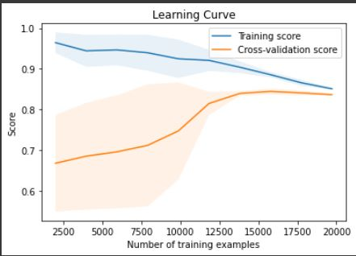
LEARNING CURVES
LOGISTIC REGRESSION
LOGISTIC REGRESSION
KNN
SVM
RANDOM FOREST
DECISION TREE

Slide 19
SUMMARY & Conclusion
Learning Outcomes
Gained Financial Knowledge
Knowledge about how insurance company works
Knowledge about Vehicle Insurance terminology and statagies
How to Handle Missing values
Learned Handle Data Imbalance
How to handle Multicollinearity
Learned various python libraries and methods
Presentation skills
Various EDA visualizations
Here I can conclude that I have gained knowledge regarding real-time projects and various domains.

Slide 20
THANK YOU

